Slide 1

Python class 4
Review; Instance versus class; functions

Slide 2
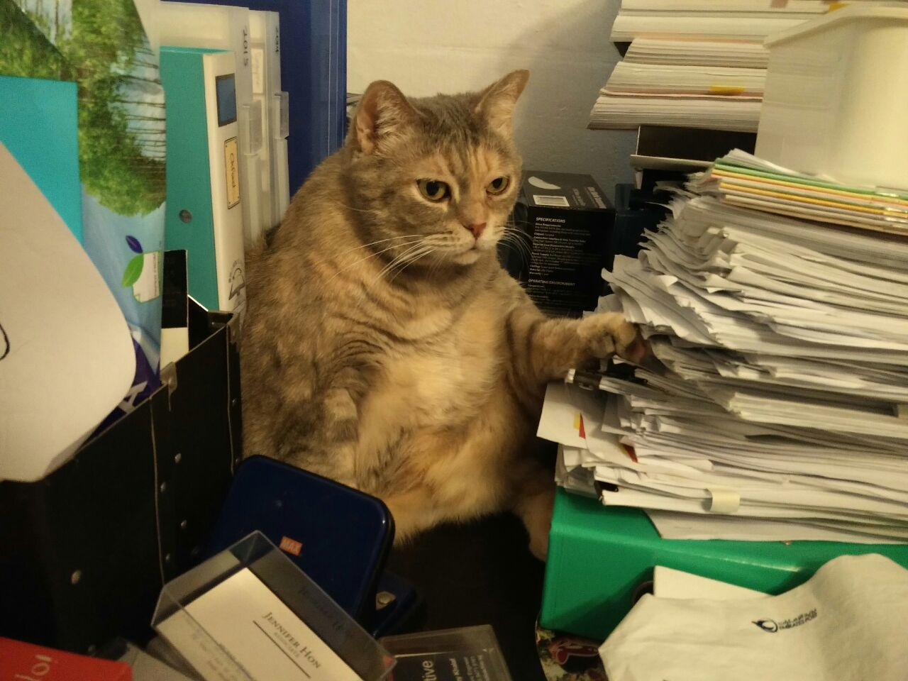
Take the review quiz on Teams

Slide 3
Line Counters
In IDLE, you can turn line counters on or off.
Line counters are useful!
You should always turn them on.

Slide 4
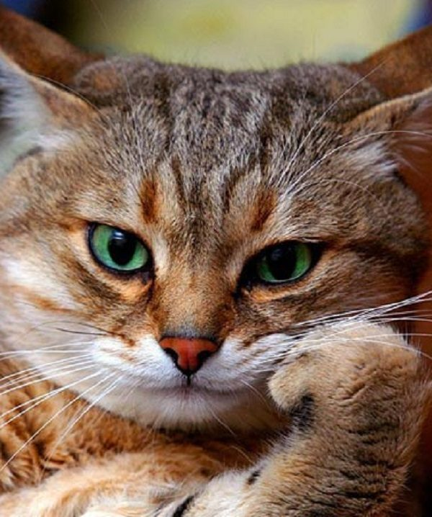
Line Counters, Cont.
Why do you think line counters are useful?

Slide 5
Line Counters, Cont.
Debugging
Finding changes
Finding a piece of code

Slide 6
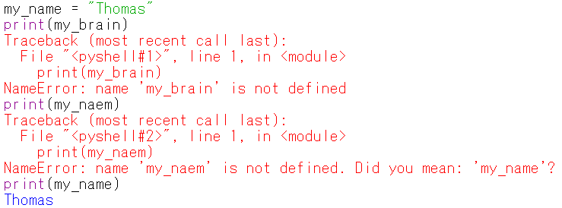

Slide 7
Libraries
There are several types built-in to Python.
Str, float, integer, and bool are some of them.
There are also many different functions built-in to Python.
print, type, len, and many more are good examples.
BUT!!!

Slide 8
Libraries, Cont
There are MANY more types and functions.
These are found in libraries.
In programming, a library is a collection of types and functions that is separate from the main language.

Slide 9
Libraries, Cont
To use a library in Python, you need to use import.

Slide 10
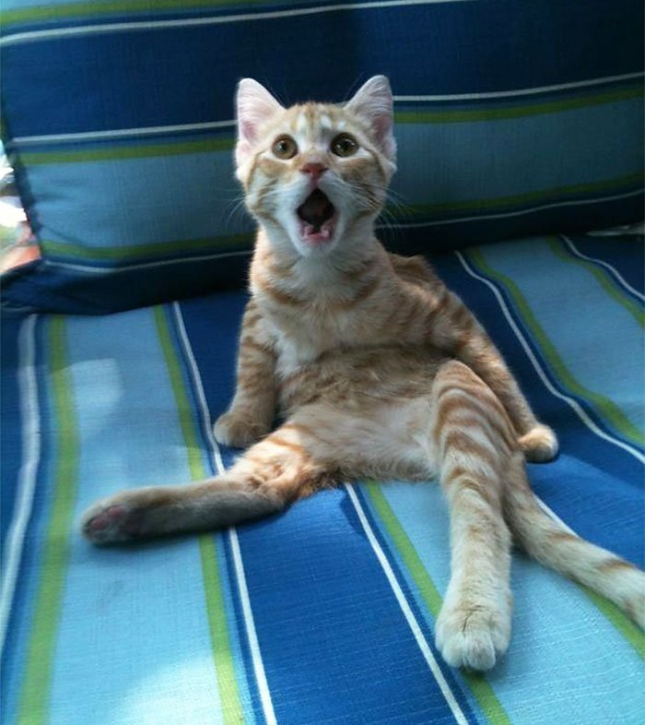
Import
import datetime
If you don’t import, you cannot use the classes and functions inside the library
Remember to import!

Slide 11
How many libraries are there?
Try this: type
help('modules')
in the Python Idle shell

Slide 12

Delicious!!

Slide 13
Imagine two cases
Buy chicken, ketchup, kochijian, honey, lemon juice, chili powder, flour, sesame seeds, sesame oil
Cut the chicken, bread the chicken.
Make the sauce.
Fry the chicken, then add the sauce. Top with sesame seeds.
Buy frozen fried chicken, sesame seeds, and yang nyeom sauce.
Cook the fried chicken, then fry with the sauce.
Top with sesame seeds.
A
B
Which is easier?

Slide 14
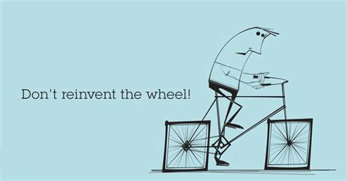
Save time and effort
We can save time by using a library.
Many programmers have worked hard to create these libraries.
cpython/datetime.py at 3.10 · python/cpython (github.com)

Slide 15
A STRING PROGRAM
Write a program using strings, ints, bools, and floats.
Let’s make variables to hold this information.
favorite writer’s first name (str)
favorite writer’s last name (str)
favorite writer’s country (str)
favorite writer’s birth year (int)
favorite writer’s birth month (int)
favorite writer’s birth date (int)
favorite writer’s famous book (str)
favorite writer’s age (float)
favorite writer’s living status (bool)
favorite writer’s marriage status (bool)
Use print to show this information.
Use different str functions to check the formatting. (upper, title, islower)

Slide 16
A STRING PROGRAM
Write a program using strings, ints, bools, and floats.
Let’s make variables to hold this information.
favorite writer’s first name (str)
favorite writer’s last name (str)
favorite writer’s country (str)
favorite writer’s birth year (int)
favorite writer’s birth month (int)
favorite writer’s birth date (int)
favorite writer’s famous book (str)
favorite writer’s age (float)
favorite writer’s living status (bool)
favorite writer’s marriage status (bool)
Use print to show this information.
Use different str functions to check the formatting. (upper, title, islower)
Let’s import datetime and use a class /type called datetime.date for this instead.
Let’s find the difference between now and the birth date

Slide 17
Python Class Extra
Using Github

Slide 18

What is Git?
Git is software that records changes in files.(変更履歴を記録・追跡するためのソフトウェア)
It was created in 2005 by Linus Torvalds.

Slide 19
Why use Git?
As you program something new, it is easy to break a working program.
Git lets you go back to the working version.
Git lets many team members work on the project at the same time.

Slide 20
How to make an account
Go to https://github.co.jp/
Click サインアップ
Enter a username, your email, and a password.
Select the free option.
Verify your email address.

Slide 21
How to make a repository
Login to your git account.
Click the plus button in the right corner.
Select New Repository ( リポジトリ ).
Give your repository a name.

Slide 22
How to upload a file
Click on the add file button.
Select upload files.
Press Commit! -> If you don’t commit, the file will not be saved.

Slide 23
How to download a file
Option 1: Copy and paste the code directly.
Option 2: Click Code.
Select Download zip.

Slide 24
Instance versus Class
There is an important difference between an instance and a class.
The instance is the actual object (実体;実例)
The class is the group (種類).
Humans, Japanese people, and Manga artists are all groups or classes.
Kentarou Miura, Eiichiro Oda, Naoko Takeuchi, and Hiromu Arakawa are instances of each class.

Slide 25
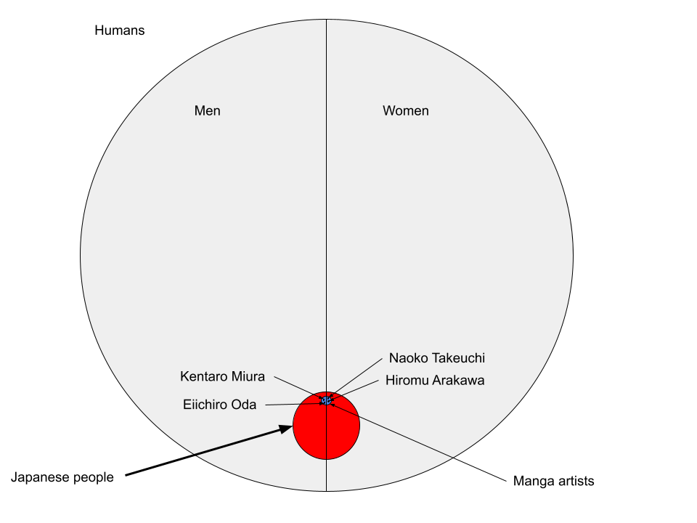
Instance versus class

Slide 26
Instances in programming
pet_name = “Angel”
pet_name is an instance of the string class.
We know it is a string because of the value we assigned it.
Because it is an instance of the string class, we can use string functions, like
pet_name.isupper()

Slide 27
Instances in programming
pet_age = 8.6
pet_age is an instance of the float class.
We know it is a float because of the value we assigned it.
Because it is an instance of the float class, we can use float functions, like
pet_age.hex()
pet_age.is_integer()

Slide 28
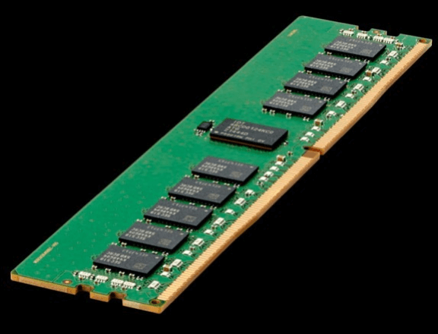
Instances versus class: Using the ID function
Make 4 variables – a string, float, int, and bool.
Use id(variable) to see the variable’s memory location on the computer.
Use id(type(variable)) to check the memory location of the variable’s type.

Slide 29
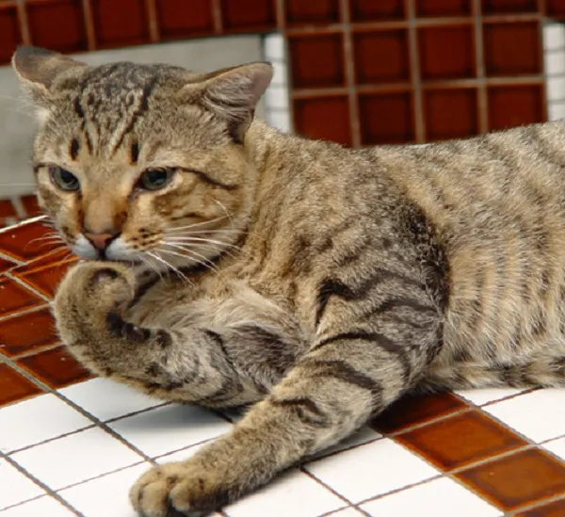
Instances versus class: Using the ID function
What do you notice about the length of the id?
Try running this several times.
What do you notice now?

Slide 30
Literals
The data that we store in variables is mostly literals (リテラル - Wikipedia)

